Slide 1

IoT and Big Data in Energy
Big data and intelligent applications
University of western Macedonia
Christos Dalamagkas – cdalamagkas@uowm.gr
Prof. Panagiotis sarigiannidis – psarigiannidis@uowm.gr

Slide 2
Outline
Power Grid architecture
Introduction to Smart Grids
IoT devices in Energy
Big data case studies in Energy

Slide 3




The Traditional Power Grid - Simplified
The Greek Case

Slide 4
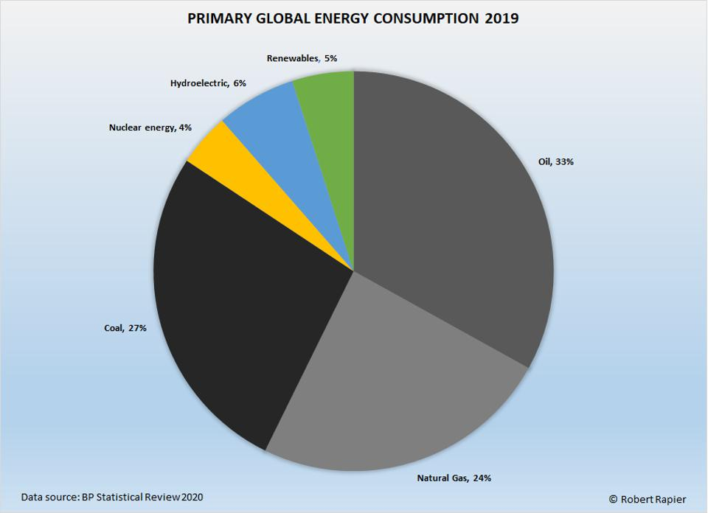
Generation ^{1/2}
Thermal Power Stations: Convert heat into electricity
Coal-fired power stations
Oil power plants – Autonomous Power Stations in remote islands
Gas-fired power plant
Nuclear energy
Combined-cycle power plant
Assembly of heat engines working in tandem to maximise energy utilization
Controllable and predictable generation

Slide 5
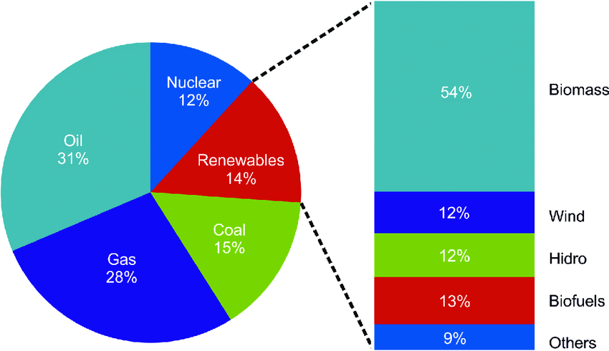
Generation ^{2/2}
Renewables penetrating the energy mix:
Biomass: Using/burning organic material to generate electricity or heat
Wind farms
Solar (PV) plants
Hydro Plants
Biofuel (fuel derived from biomass, ethanol, biodiesel, etc)
Production varies depending on weather conditions
Fluctuations is a great challenge, whilst supply and demand balance must be maintained

Slide 6
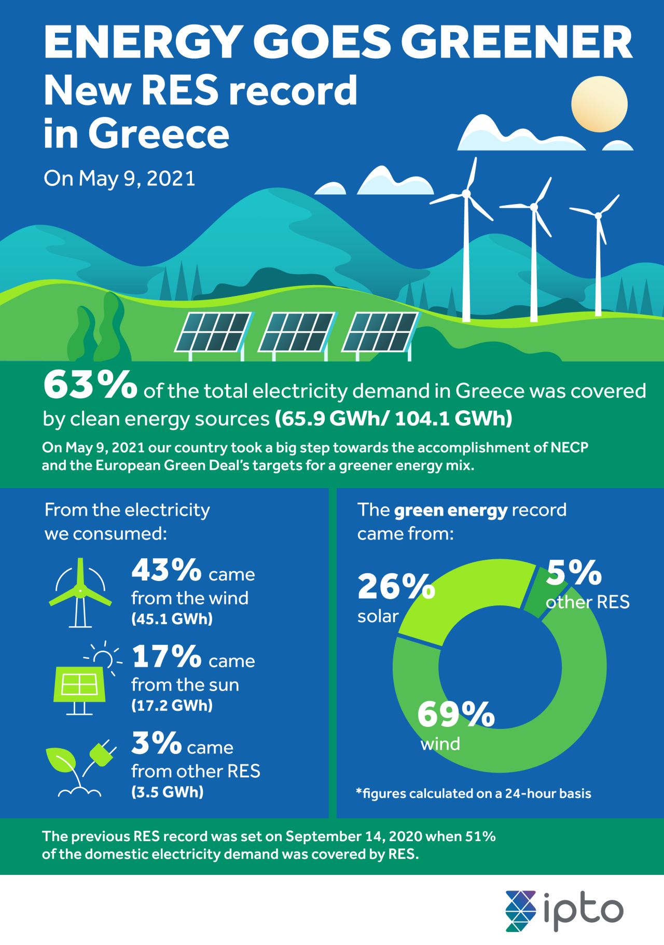
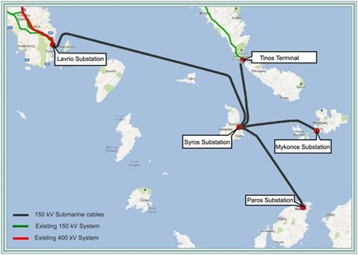
New RES record in Greece!
Penetration of RES rapidly increases
51% of domestic energy demand covered by RES (Sept 2020)
63% of domestic energy demand covered by RES (May 2021)
Recently, the Cyclades-Lavrio interconnection has been completed, turning off oil power plants in 4 islands
https://www.sdnmicrosense.eu/towards-securing-large-scale-grid-interconnection-infrastructures/

Slide 7
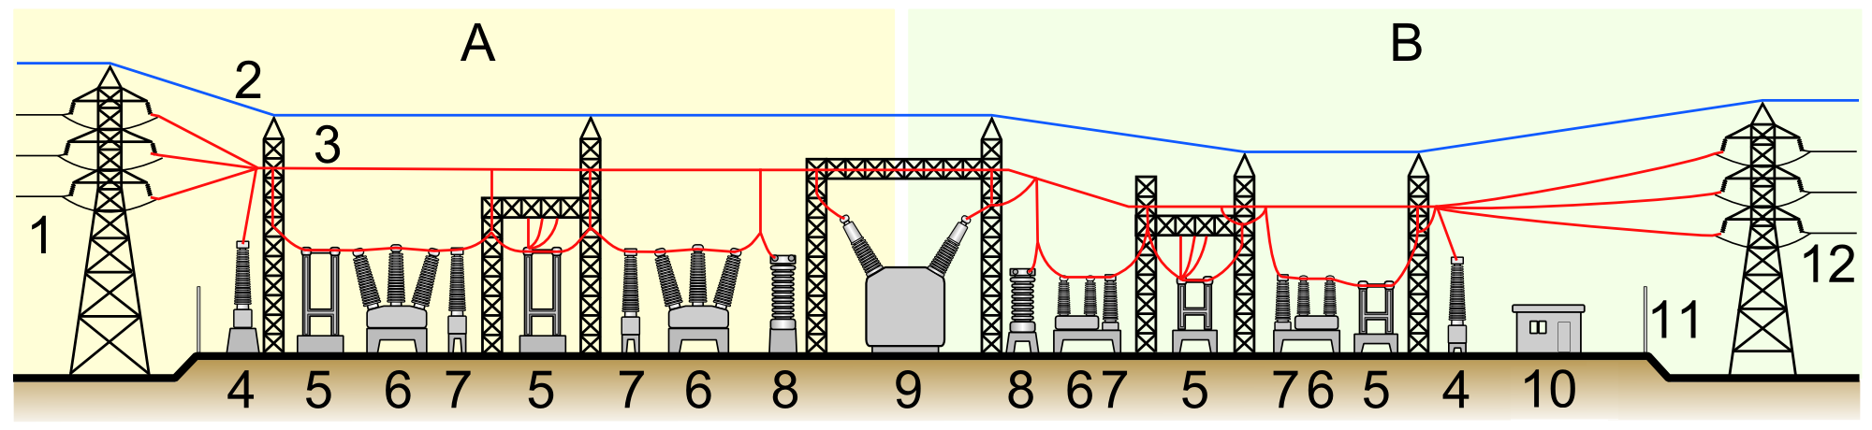
Transmission
A: Before transformation
B: After transformation
Moving energy from generation to a substation
To minimize energy loss, transmission happens in high and ultra-high voltage
Substations include transformers that change voltage to facilitate energy distribution
Remotely supervised by SCADA (Supervisory Control and Data Acquisition)
Transmission grid and substations operated by the Transmission System Operator (TSO)
Elements of a substation A: Primary power lines' side B: Secondary power lines' side 1. Primary power lines 2. Ground wire 3. Overhead lines 4. Transformer for measurement of electric voltage 5. Disconnect switch 6. Circuit breaker 7. Current transformer 8. Lightning arrester 9. Main transformer 10. Control building 11. Security fence 12. Secondary power lines
Image Source: Wikipedia

Slide 8
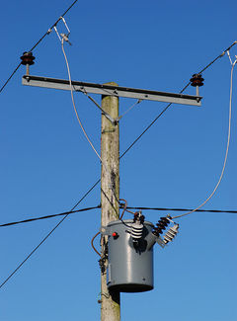
Distribution
The final stage of delivering energy to consumers
Intermediary transformers reduce voltage in the area of neighborhood
Renewables are more attached to the distribution grid rather than the transmission grid
Smart meters are replacing analog energy meters
The distribution system operator (DSO) maintains
Distribution grid (infrastructure)
New connections to the distribution grid
(Smart) metering

Slide 9
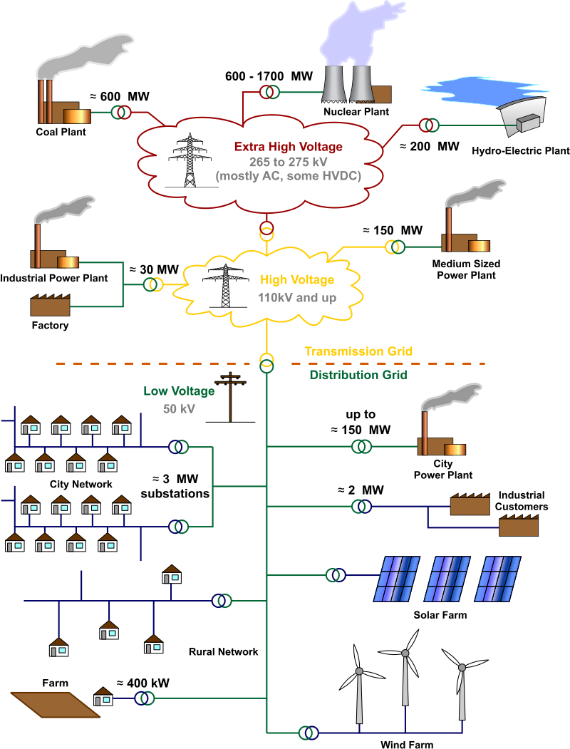
Energy grid in detail
Most of the energy generation is connected to transmission grid
Each energy generation site has step-up transformers/substations, operated by TSOs
TSOs undertake to transmit energy across the country (+ connecting mainland with islands)
Step-down transformers reduce voltage (transmission → distribution)
Solar and wind plants are connected directly to the distribution grid
Image source: Wikipedia

Slide 10
Why IoT in Energy?
Renewable Energy Sources (RES) are penetrating the traditional energy grid
RES introduce new challenges
Decentralized energy generation – Multiple distributed stations connected to the grid
Generation depends on weather conditions – Load and supply must always balance!
Fluctuations may disrupt the equipment and the infrastructure
Continuous monitoring is needed to ensure grid stability
Digitalizing existing infrastructure
Introduce digitalized metering and build historic log of electricity measurements
More frequent and high-precision electricity measurements
IoT is not only for RES:
Real-time monitoring, analytics and ability for immediate reaction to emergencies can be provided by IoT
IoT in every-day energy management:
IoT solutions help organisations to monitor energy consumption

Slide 11
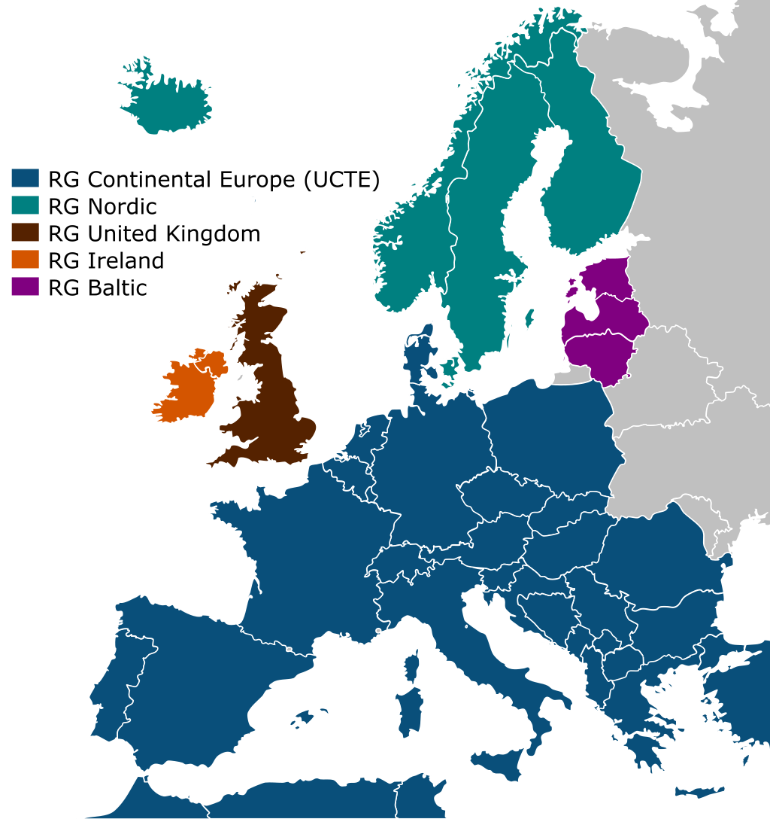
Quick notes on grid stability
In any electric system, the generated active energy must match the consumed at any time
The system frequency is a measure for the rotation speed of the synchronized generators (50Hz)
By increasing total energy demand, the system frequency decreases, and vice versa
Deviations on system frequency can harm the infrastructure. Methods to ensure grid stability:
Droop control
Load shedding
Intentional Islanding
Dynamic Response / Demand Response
+/- 200 millihertz maximum tolerable deviation
UCTE is the largest synchronous electrical grid

Slide 12
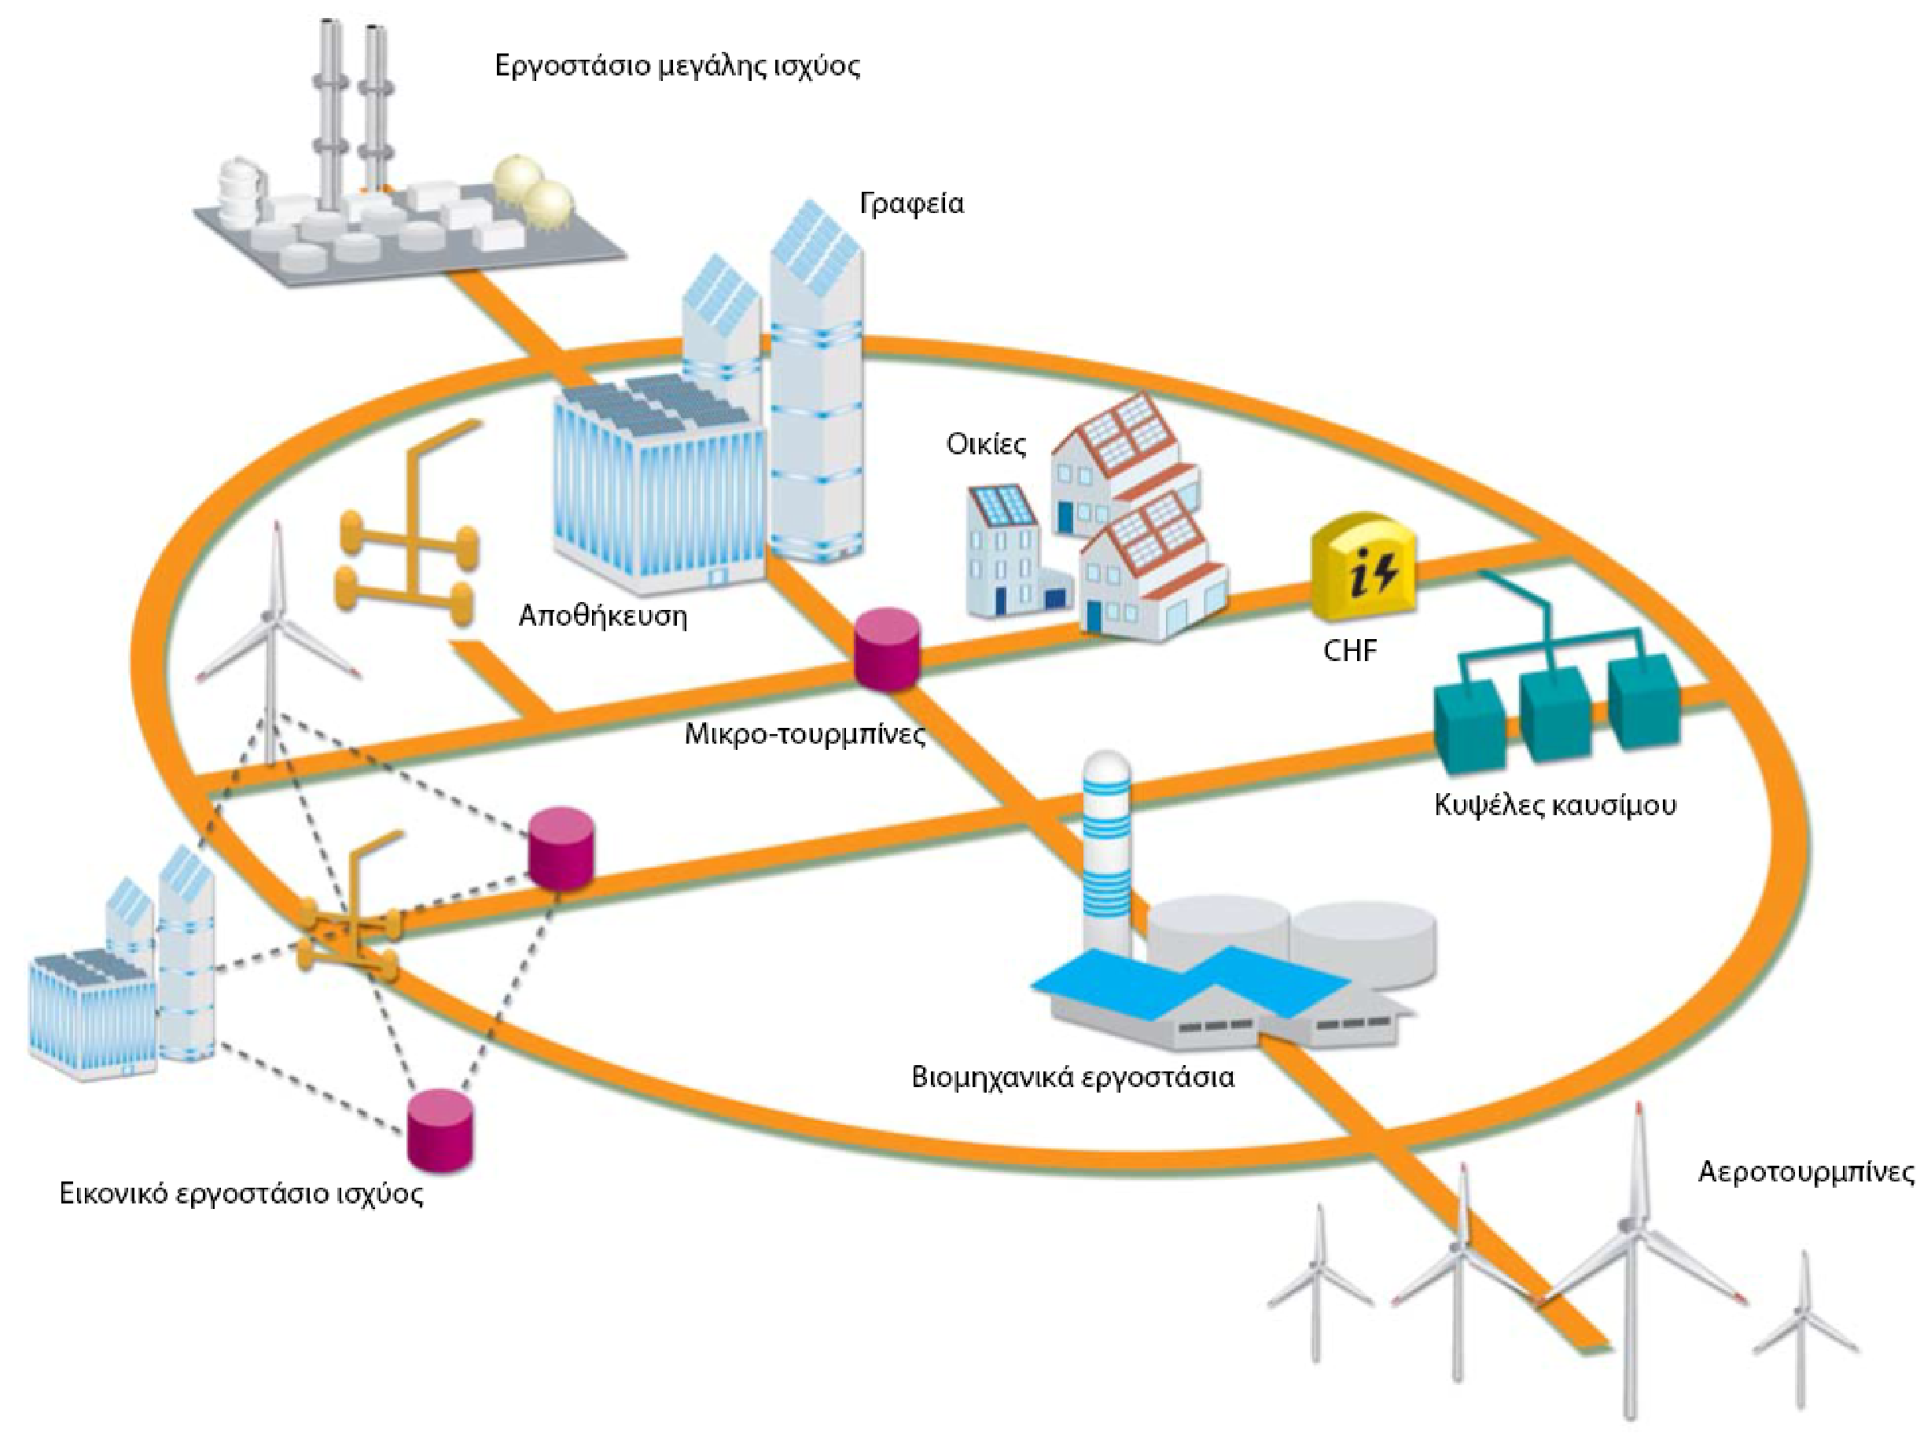
The Smart Grid Concept
High-power stations
Smart offices
Energy production in multiple parts of the grid
Various power sources are integrated in the interconnected, “flat” power grid
Consumers are now prosumers (producers+consumers)
Consumers are no more passive
Intelligence and smart control distributed across the grid
Smart Homes
Storage
Micro-turbines
Fuel cells
Industry
Wind turbines
Virtual power plant

Slide 13
Big data sources in Energy
Renewable energy data: Smaller capacity units, their production varies depending on weather conditions
Wind farm data: More than 300 data features (attributes) for monitoring a modern windmill. Maintenance cost is about 20–25% of the cost per kilowatt supplied
Grid operation Data: Huge amounts of data need to be transferred, stored and visualized in near real-time, to provide immediate response in case of disruptions; PMUs are the pioneer in big data generation.
A typical power plant unit may provide up to 3000 data features (temperatures, pressures, etc) frequently sampled. A power plant may have multiple power plant units!
Load metering data: Smart meters enable frequent two-way communication with the customer; Demand-side management can adjust the customer’s load
Market data: Intraday electricity markets provide a continuous flow of information about market conditions and indirectly about electrical system conditions

Slide 14
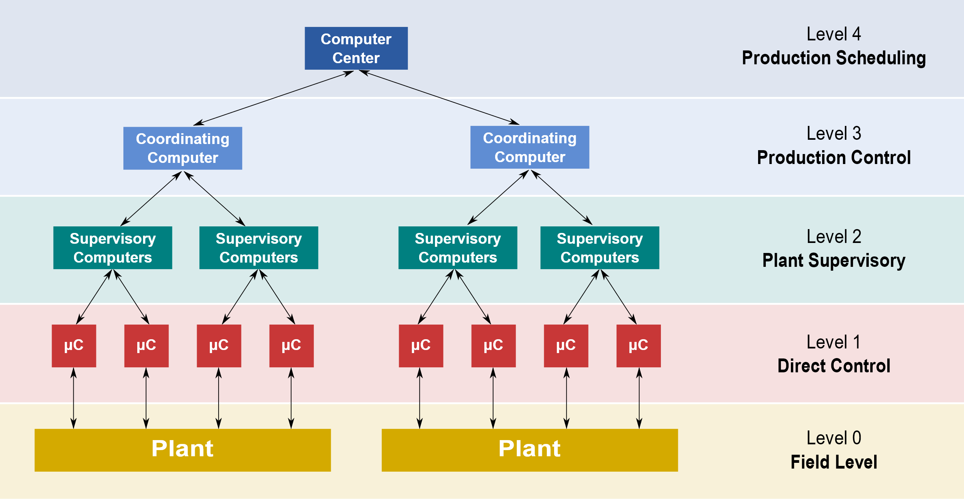
Smart Grid Components

Slide 15

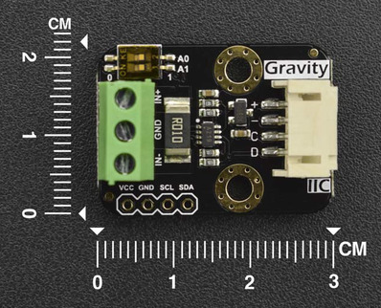
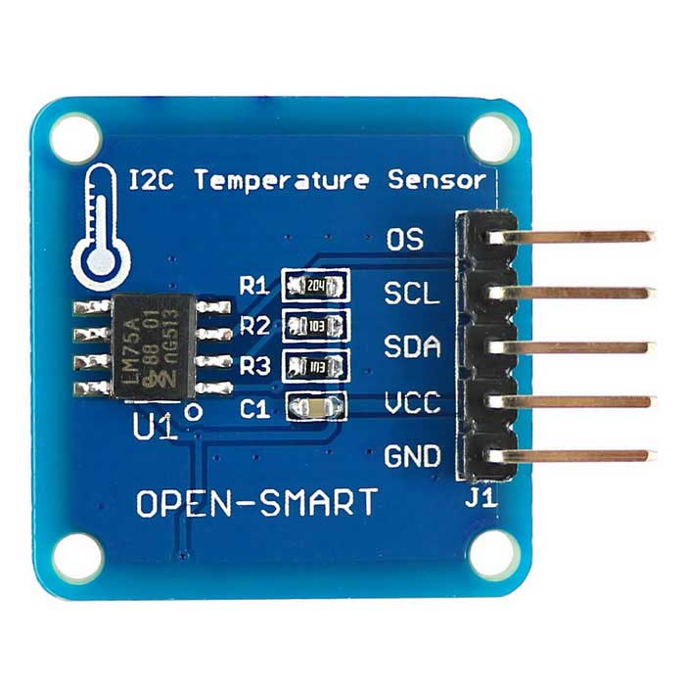
L0 (Field Level)
Consists of field devices
Flow sensors
Temperature sensors
Valves
Pressure sensors
Volt/Ampere meters
Primary data source
Analog measurements that need conversions

Slide 16
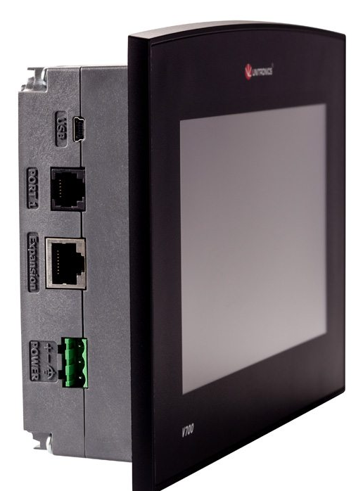
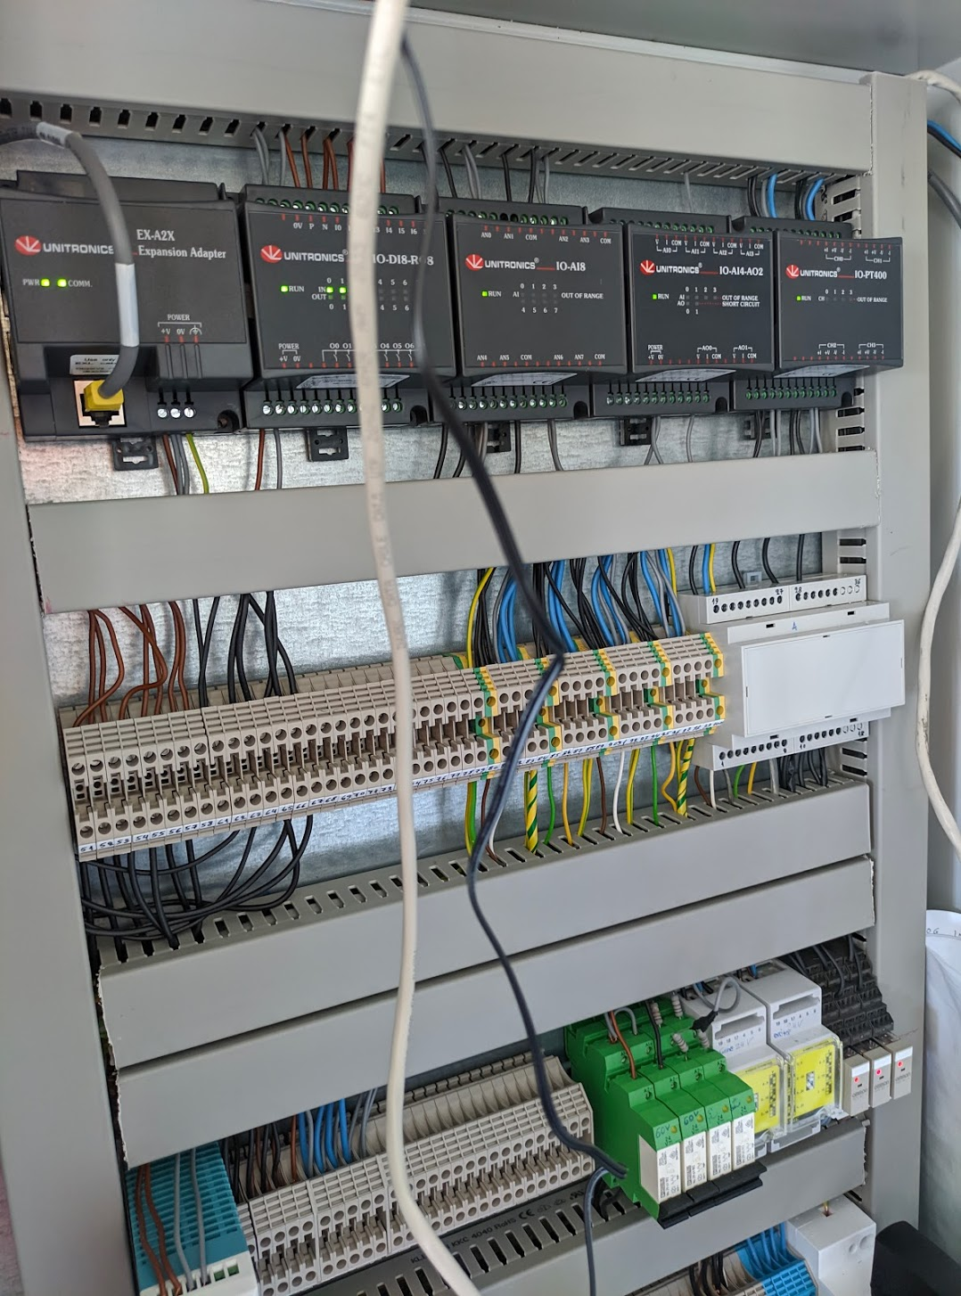
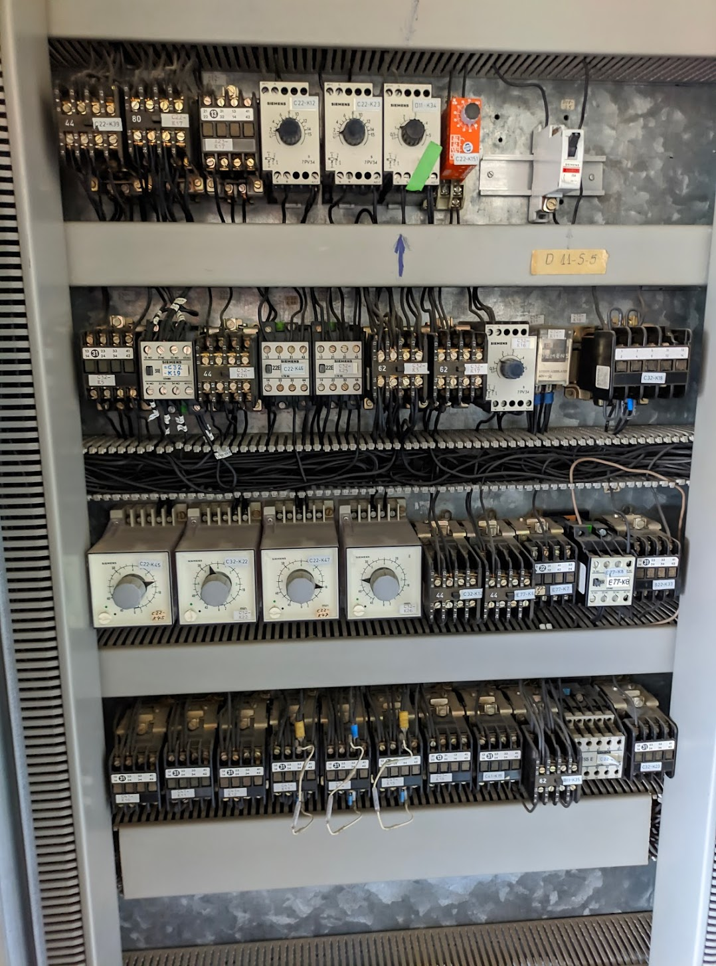
L1 (Direct Control)
Analog (bellow) vs digital (right) automation
Advanced devices that receive analog signals and implement control logic
Modern L1 assets consist of:
Industrialized I/O modules
Electronic processors
Devices in L1:
Programmable Logic Controllers
Remote Terminal Units
Smart Meters
Power Analyzers
Phasor Measurement Units
Protective Relays
Smart Inverters

Slide 17
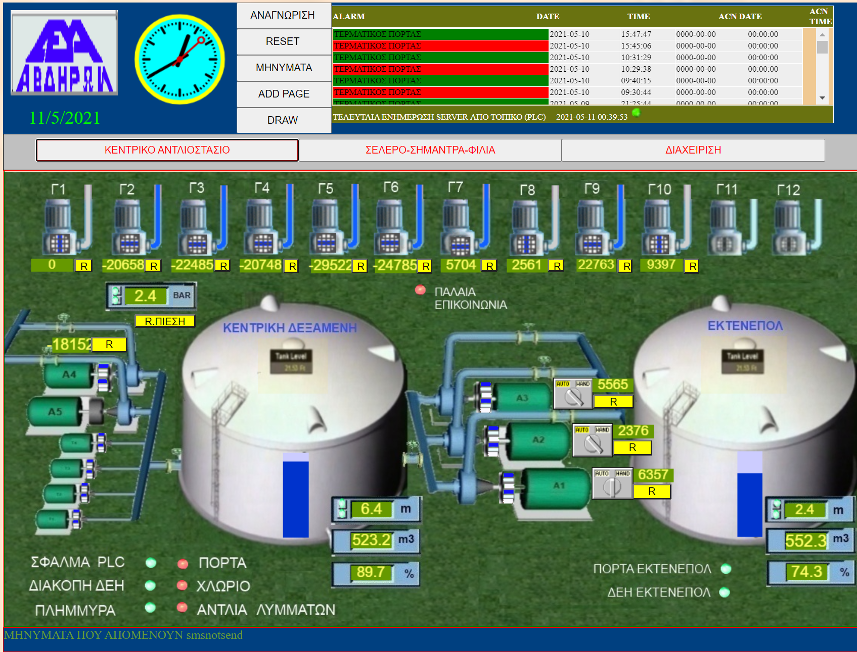
L2 (Plant Supervision)
The control room(s) that collect and centralize information, providing the operator with control screens and the overall status
SCADA: Supervisory Control and Data Acquisition, collects data from the plant and applies controls
Data may be also redirected to Data Management Systems for long-time storage. Useful for troubleshooting, auditing in case of severe faults, analytics
HMI: Human Machine Interfaces, visualise the plant data
Other types of supervision: Distributed Control Systems (DCS), Wide Area Measurement Systems, Energy Management Systems (EMS), Advanced Metering Infrastructure/Reading (AMI/AMR)
SCADA (avdiracontrol.gr)

Slide 18
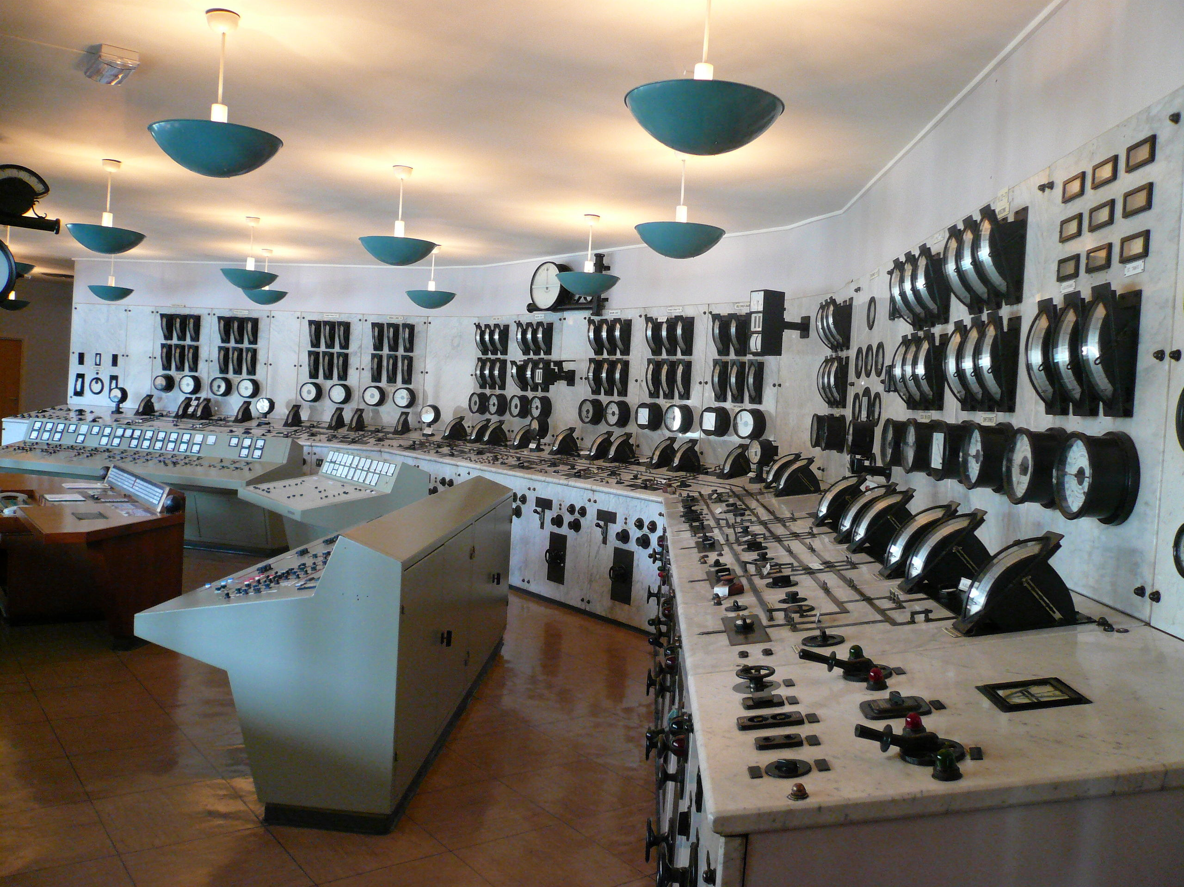
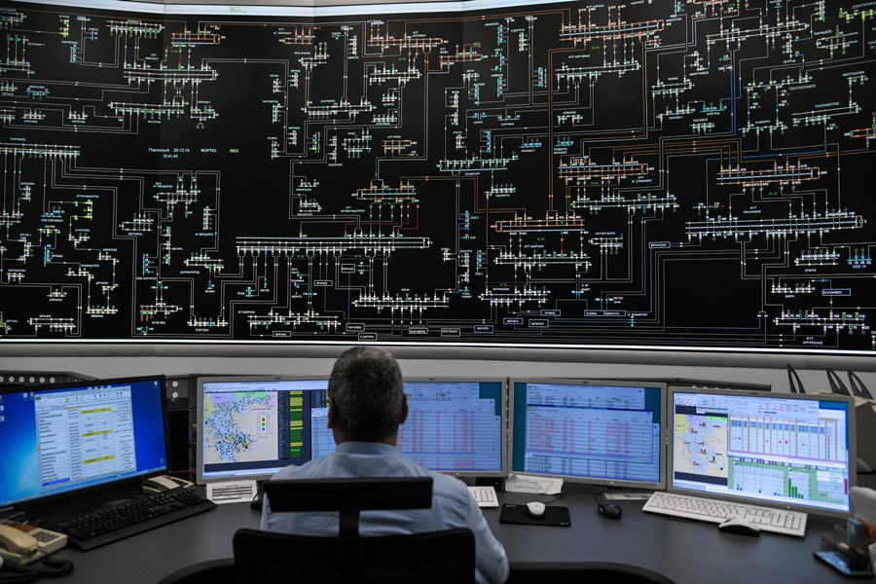
Legacy vs Modern Supervision Systems
IPTO EMS
Legacy EMS

Slide 19
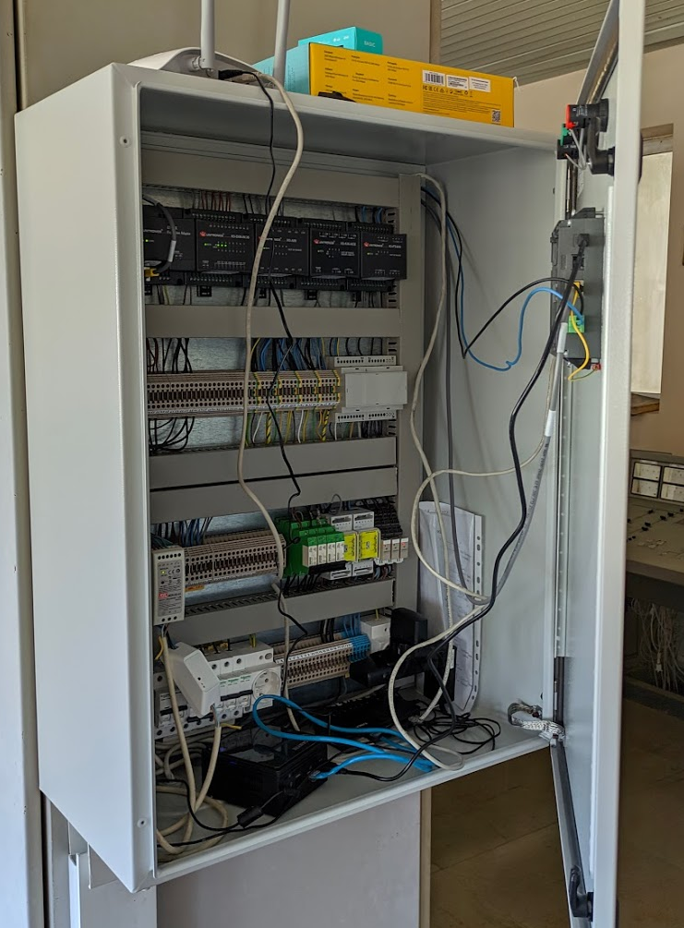
L1 (Direct Control) / PLCs
I/O Modules
Programmable Logic Controllers (PLCs):
Programmable devices that convert analog signals to digital
Using LADDER, PLCs can be programmed to digitalize analog signals (electricity measurements) and take decisions or raise alarms
PLCs replace conventional hard-wired relay logic
May integrate Human Machine Interface. Example: Unitronics Visio700
Interfaces: USB, RS-232, RS-485, Ethernet
IoT Communication protocols: Modbus, EtherNet/IP (IP = Industrial Protocol), EtherCAT, CANopen, PROFINET
Use Cases: Implementing safety mechanisms, digitalizing measurements from analog sensors
IEC 61131-3 is the standard describing the LADDER logic
PLC
Rectifier
SONOFF Switch
NUC PC for programming the PLC via USB

Slide 20
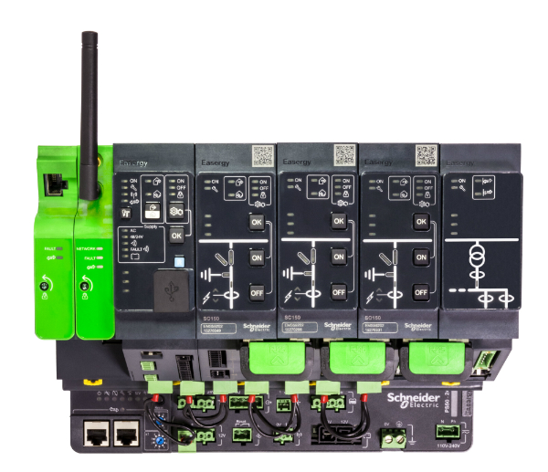
L1 (Direct Control) / RTUs
Remote Terminal/Telemetry Units, transmit telemetry data to a central control system (SCADA)
Integrates I/O modules for interfacing analog physical objects to the digital world (similarly to PLCs)
RTUs incorporate multiple communication interfaces, including wireless
They usually don’t support control loops and algorithms
Used mainly in substations utilizing wireless communications, whereas PLCs are better with local controls (production lines, power plants etc)

Slide 21
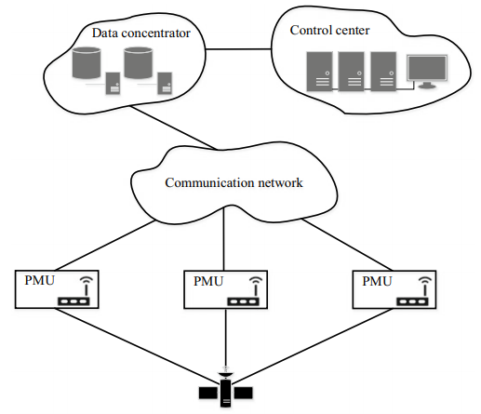
Wide Area Measurement Systems
A more complex and “fluent” energy grid requires enhanced, real-time monitoring on grid stability
SCADA is not sufficient for high sampling rates and precisely synchronized measurements
WAMS focuses on enhancing the grid observability and quick response. Integrates:
Phasor Measurement Units (PMUs)
Phasor Data Concentrators (PDCs)
GPS clocks
High-speed communication links (usually, optical fibre)
PMUs are placed in various locations across the distribution and transmission grid
PDCs collect measurements from multiple locations, which are then visualised in the control centre
Wide-Area Measurement Systems and Phasor Measurement Units | SpringerLink

Slide 22
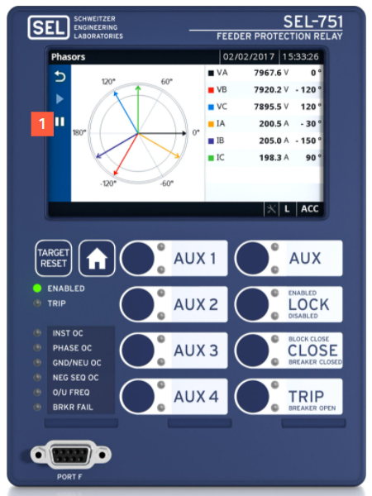
Phasor Measurement Units
Advanced metering devices used to estimate the magnitude and phase angle of an electrical phasor quantity
The phasor quantity is reconstructed by capturing multiple samples in quick succession, properly synchronized
IEEE 1518 (Precision Time Protocol) and GPS are usually utilized for higher accuracy
The resulting measurement is called synchrophasor
PMUs are independent devices or integrated in more complex devices (e.g., protective relays)
Synchrophasors are used to monitor frequency deviations
Significant deviations from 50Hz can damage infrastructure
Loss of demand and supply balance contribute to frequency deviations

Slide 23

Phasor Data Concentrators (PDCs)
Software component that receives synchrophasors from PMUs, using the IEEE C37.118 protocol
PDCs calculate statistic history, e.g., average latency, data quality and time code errors
Connection with external databases, including Oracle, MySQL, Microsoft SQL Server.
Multi-node architecture for fault-tolerance
Outputs can also be delivered to Apache Handoop for big data analytics
100 PMUs may generate up to 6.2 billion data rows per day, at 60 GB!
openPDC is an opesource implementation of an IEEE C37.118 compliant PDC
P. Mack, “Big Data, Data Mining, and Predictive Analytics and High Performance Computing,” in Renewable Energy Integration, Elsevier, 2014, pp. 439–454 [Online]. Available: http://dx.doi.org/10.1016/B978-0-12-407910-6.00035-1

Slide 24
Self-healing with PMUs/PDCs
Maintaining Quality of Service (QoS) in WAMS is an active research topic
Traffic Engineering and OpenFlow can be leveraged to rearrange communication paths according to QoS constraints
In case of communication failure or PDC failure, its important to reconnect the disconnected PMUs as fast as possible
A problem of optimal PMU to PDC allocation has the following constraints:
Minimize latency between PMU and the new PDC
Maximize available bandwidth
Minimize packet loss
Minimize security risk
Y. Qu, X. Liu, D. Jin, Y. Hong, and C. Chen, “Enabling a Resilient and Self-healing PMU Infrastructure Using Centralized Network Control,” in Proceedings of the 2018 ACM International Workshop on Security in Software Defined Networks & Network Function Virtualization, 2018, doi: 10.1145/3180465.3180472 [Online]. Available: http://dx.doi.org/10.1145/3180465.3180472

Slide 25

Advanced Metering Infrastructure
AMI is composed of advanced energy meters (smart meters), a two-way communication channel, a data repository, and the AMI headend
AMI enables new opportunities:
Demand response: A wide range of actions, taken at the customer side in response to conditions within the electricity system (peak period network congestion, high prices, changing between different retailers, etc)
Dynamic pricing and policies from the DSO (e.g., limiting maximum consumption in case of balance due)
DLMS and OSGP are well-known protocols utilized by smart meters
GuruX is an opensource solution for custom AMIs (https://www.gurux.fi/)
Advanced Metering Infrastructure (AMI) - CIO Wiki (cio-wiki.org)

Slide 26
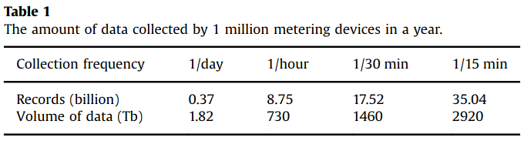
Advanced Metering Infrastructure
Customer’s electricity consumption is collected each 24 hours, 1 hour, 30 min or 15 min
Considering an energy utility of 1.000.000 customers and that the size of each record is 5 KB:
K. Zhou, C. Fu, and S. Yang, “Big data driven smart energy management: From big data to big insights,” Renewable and Sustainable Energy Reviews, vol. 56, pp. 215–225, Apr. 2016, doi: 10.1016/j.rser.2015.11.050.

Slide 27
Communications in Energy / Fieldbus
Specialized communication protocols for reliable, real-time and flexible message exchange
Computer networks:
Serial Fieldbus
(Industrial) Ethernet
Fieldbus: Real-time networking using mostly serial communications
Daisy-chain / ring
Bus
Tree
Fieldbus is standardized by IEC 61158
Fieldbus Protocols: MODBUS RTU, PROFIBUS I/O, etc

Slide 28
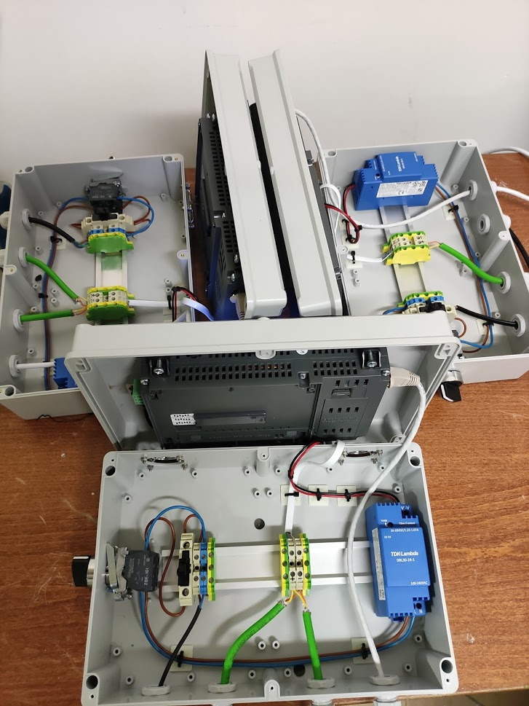
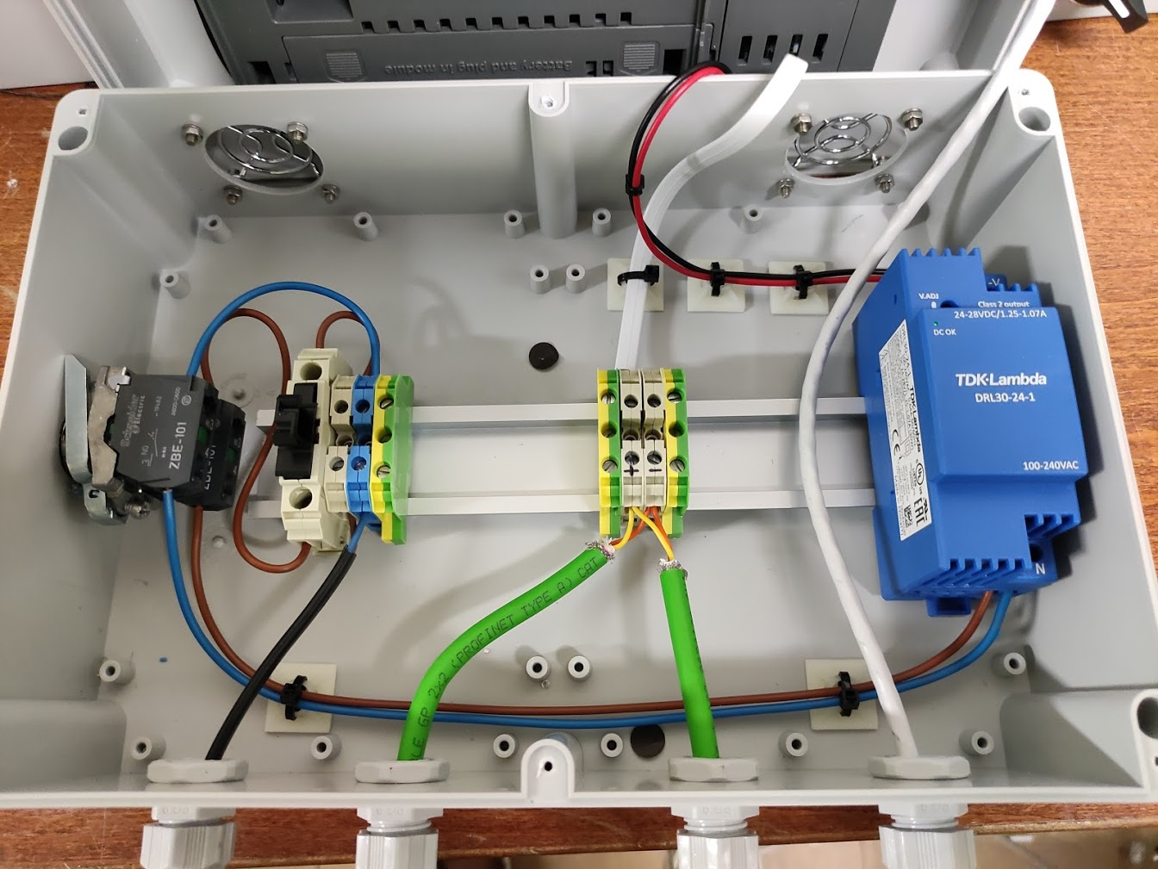
Connecting
Fieldbus (Modbus RTU – RS485) Example

Slide 29
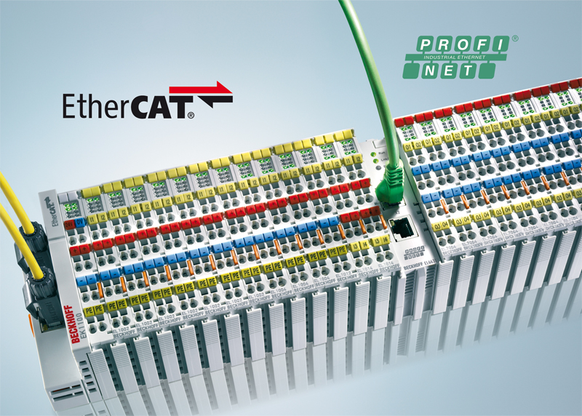
Industrial Ethernet
Encapsulating fieldbus over Ethernet
Slightly altered Ethernet to provide real-time control and low latency
Ethernet to accomplish interoperability and convergence with computer systems
IE protocols: Modbus TCP, EtherNet/IP, Sinec H1, PROFINET, EtherCAT, etc
Disadvantages: TCP not helpful for real-time, 64-bytes minimum for Ethernet adds a significant overhead

Slide 30












SG Protocols
IEEE
C37.118
MMS/GOOSE

Slide 31
Big Data in Energy
CASE STUDIES

Slide 32
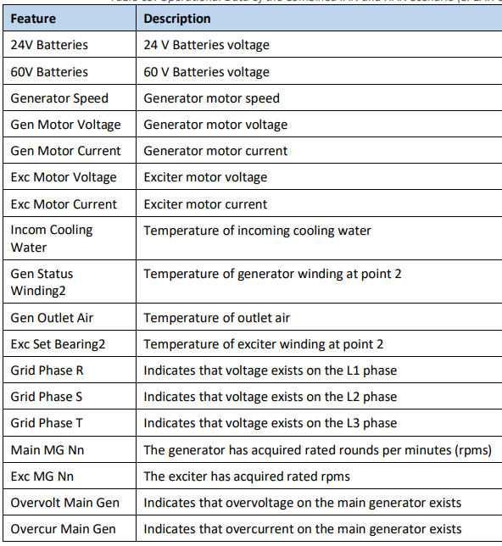
Anomaly Detection in Smart Grid ^{1/2}
Machine learning can assist in decision-making for smart grid environments
Anomaly detection on operational data:
ML models are trained on operational data generated in the plant, e.g. by a steam engine
Since its difficult to provide samples containing anomalies, ML models are trained on the normal operations
Any deviation from the trained pattern can indicate a fault → An alarm to the operator is raised
Applicable architectures:
Support Vector Machines
Isolation Forests
Angle-Base Outlier Detection
Stochastic Outlier Selection
Principal Component Analysis
Generative Adversarial Networks and Autoencoders
G. Efstathopoulos et al., “Operational Data Based Intrusion Detection System for Smart Grid,” in 2019 IEEE 24th International Workshop on Computer Aided Modeling and Design of Communication Links and Networks (CAMAD), 2019, doi: 10.1109/camad.2019.8858503 [Online]. Available: http://dx.doi.org/10.1109/camad.2019.8858503

Slide 33
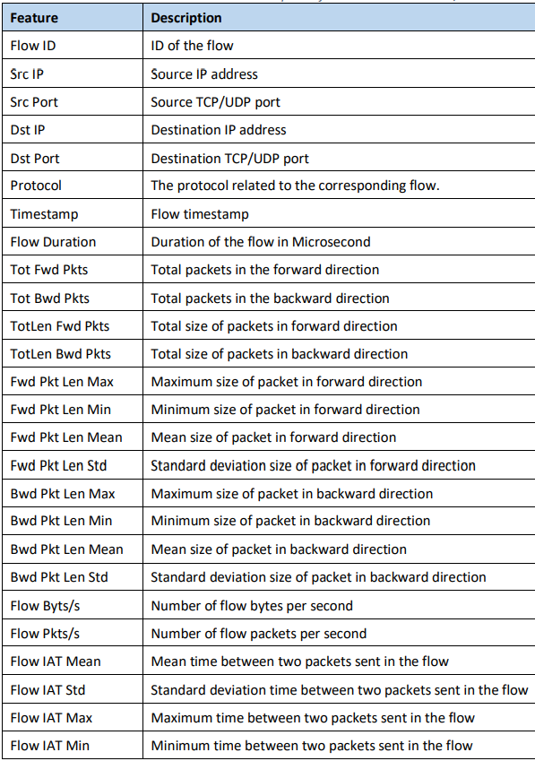
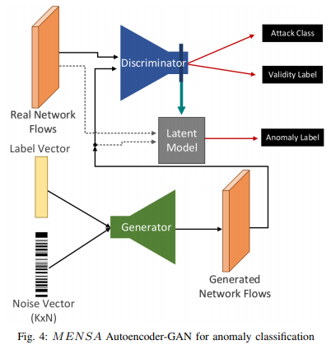
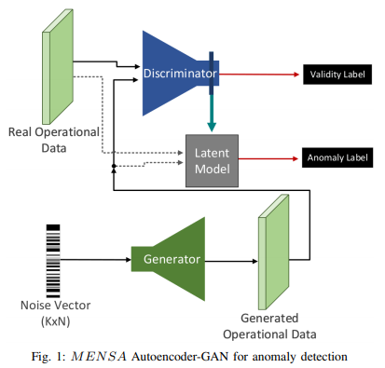
Anomaly Detection in Smart Grid ^{2/2}
Machine learning can assist in decision-making for smart grid environments
Anomaly detection on network flows:
ML models are trained on more than 80 features generated by CICFlowMeter
Capture window on 1 minute or more
Tshark/tcpdump captures are provided to CICFlowMeter
Applicable ML methods:
Decision Trees
Long-Short-Term-Memory Recurrent Neural Networks
Convolutional Neural Networks
Generative Adversarial Networks and Autoencoders
I. Siniosoglou, P. Radoglou-Grammatikis, G. Efstathopoulos, P. Fouliras, and P. Sarigiannidis, “A Unified Deep Learning Anomaly Detection and Classification Approach for Smart Grid Environments,” IEEE Trans. Netw. Serv. Manage., pp. 1–1, 2021, doi: 10.1109/tnsm.2021.3078381.

Slide 34
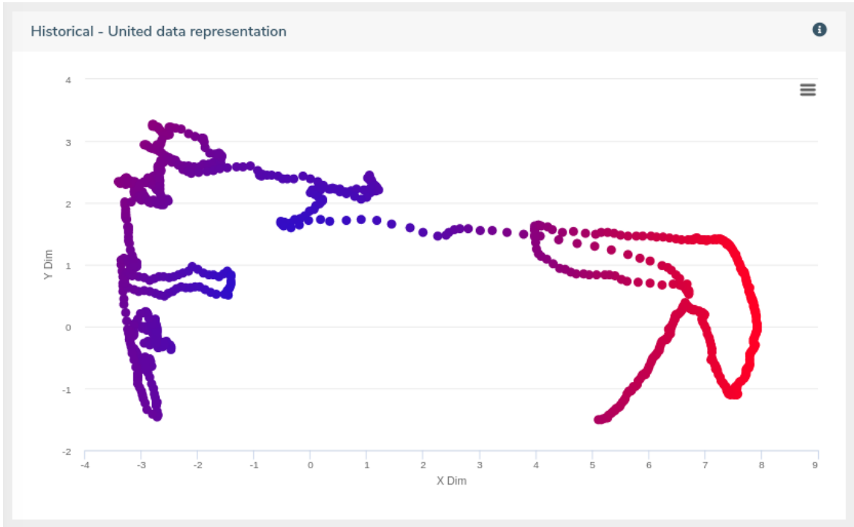
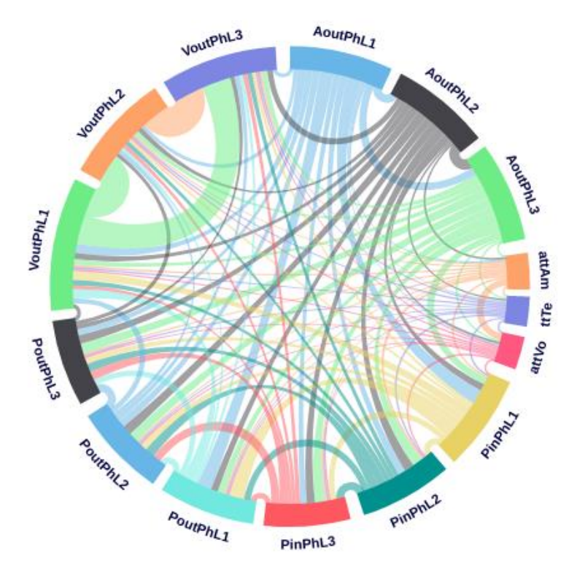
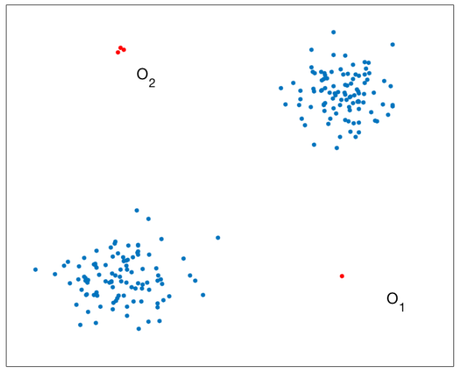
Visualisation and grid situational awareness ^{1/2}
Visual analytics provide intuitive and efficient ways to communicate complex relations and enable non-technical personnel to identify threats
Anomaly detection algorithms:
Local Outlier Factor (LOF): Computes the local density deviation of a given data point with respect to its neighbors
Multi-partite graphs
LSTM
PhDThesis_LidaRashidi.pdf (unimelb.edu.au)
SPEAR_D3.3.pdf (spear2020.eu)

Slide 35
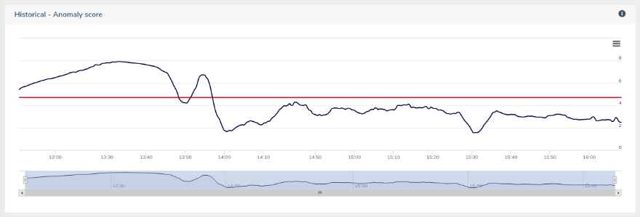
Visualisation and grid situational awareness ^{2/2}
Dimensionality reduction: Reducing dimension of complex data in order to facilitate visualisation
The challenge is to reduce dimensions while maintaining the patterns that need to be observed
Applicable methods:
Principal Component Analysis (PCA): Creates new low dimension axes that summarize the data
Singular Value Decomposition (SVD): Decomposes vectors onto orthogonal axes
Independent Component Analysis (ICA): Similar to PCA, but can find the underlying factors
Sparse Random Projection (SRP): Estimates the distances between all point pairs in a high-dimensional space.
Autoencoder (AE): Deep neural network that learns the underlying manifold or the latent space in the dataset. The encoder transforms the input to a latent space and the decoder reconstructs the input from the latent space.
Dimensionality reduction for visualization purposes in the SPEAR V-IDS - SPEAR Project (spear2020.eu)

Slide 36
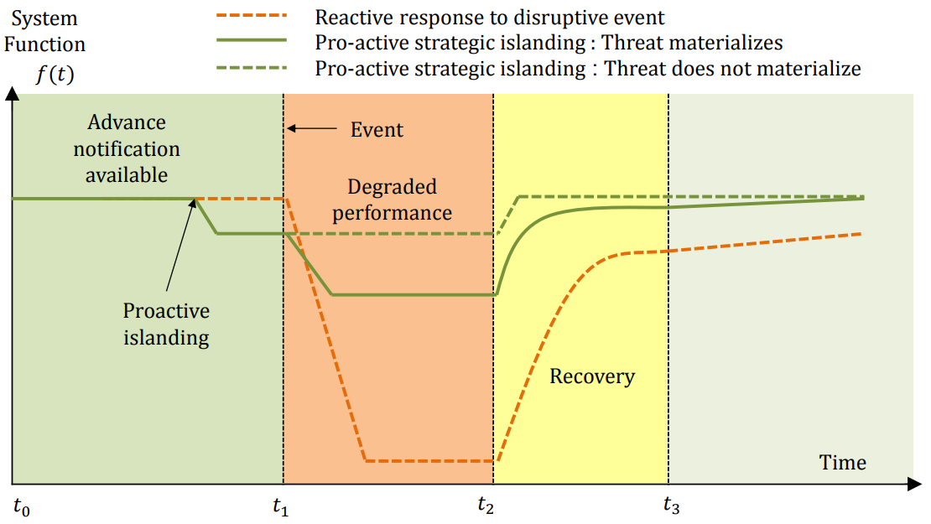
Proactive intervention
Island: Grid segment (microgrid) that is self-sufficient; Adequate generation to support the load.
When a sudden generation loss occurs, the DSO can proceed to demand-response, load shedding or islanding (amongst other)
Intentional islanding is the procedure of isolating a segment of the power grid in case of sudden loss of demand/supply balance or to stop cascading effects expected to be caused by cyberattack or natural disaster
Current State-of-Art (SoA) is to proceed to islanding after the disturbance (reactive response)
Beyond SoA: Predict upcoming failure and proceed to proactive islanding
S. Biswas, E. Bernabeu, and D. Picarelli, “Proactive Islanding of the Power Grid to Mitigate High-Impact Low-Frequency Events,” presented at the 2020 IEEE Power & Energy Society Innovative Smart Grid Technologies Conference (ISGT), Feb. 2020, doi: 10.1109/isgt45199.2020.9087788

Slide 37
Research on big-data driven smart grid management
Planning and optimising power generation
Economic Load Dispatch (ELD): An optimal combination of power generating units that minimises the total fuel cost while satisfying the load demand, subject to operational constraints
Methods: Constraint programming, dynamic programming, particle swarm optimisation, etc
Forecasting production of renewables
Methods: Time series models, ANN, SVM, etc
Asset management, Fault diagnosis and forecasting, system reliability improvement
Demand Side Management (DSM):
Load forecasting → ANN, Ant colony optimization, regression, etc
Load and consumers classification → k-means clustering,
Dynamic pricing → Least-squares SVM, economic modeling, etc
Non-interventional methods → Surveys, ad campaigns, personalized information etc
K. Zhou, C. Fu, and S. Yang, “Big data driven smart energy management: From big data to big insights,” Renewable and Sustainable Energy Reviews, vol. 56, pp. 215–225, Apr. 2016, doi: 10.1016/j.rser.2015.11.050.

Slide 38
How IoT is Transforming the Energy Industry
Remote Asset Monitoring and Management
Enhanced and dependable connectivity enables full remote monitoring and management
Massive amounts of data can be processed for understanding patterns, detect, respond and predict failures
A More Distributed Grid
RES decentralize the power grid, while consumers can also produce energy (prosumers)
More Informed Customers
Consumers can monitor their energy consumption and receive detailed reports about energy usage, thanks to smart meters
Consumers start having a more active role in the energy chain
Improved Grid Management
PMUs and advanced metering devices provide increased observability, greater accuracy and immediate response
How IoT is Transforming the Energy Industry - Renewable Energy Magazine, at the heart of clean energy journalism

